Slide 1


Game feel

Slide 2
Things that are unique to video games
Emergent behaviour
Re-playability (with different outcomes)
Game feel
Cuz games is art

Slide 3
WTF is game feel
A virtual sensation from the feedback the game is giving you
This feedback includes
Animation (Timings, exaggeration, smears, frame pauses)
Sound effects (cooldown timers, combo meters)
Controller vibration
Control scheme
Game feel is apparent at a prototype stage
Notes:
https://www.youtube.com/watch?v=pmSAG51BybY
GDC game feel demo

Slide 4
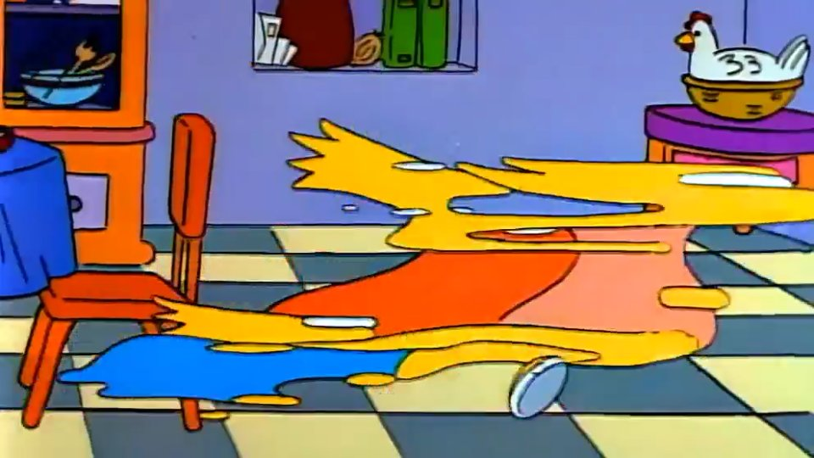
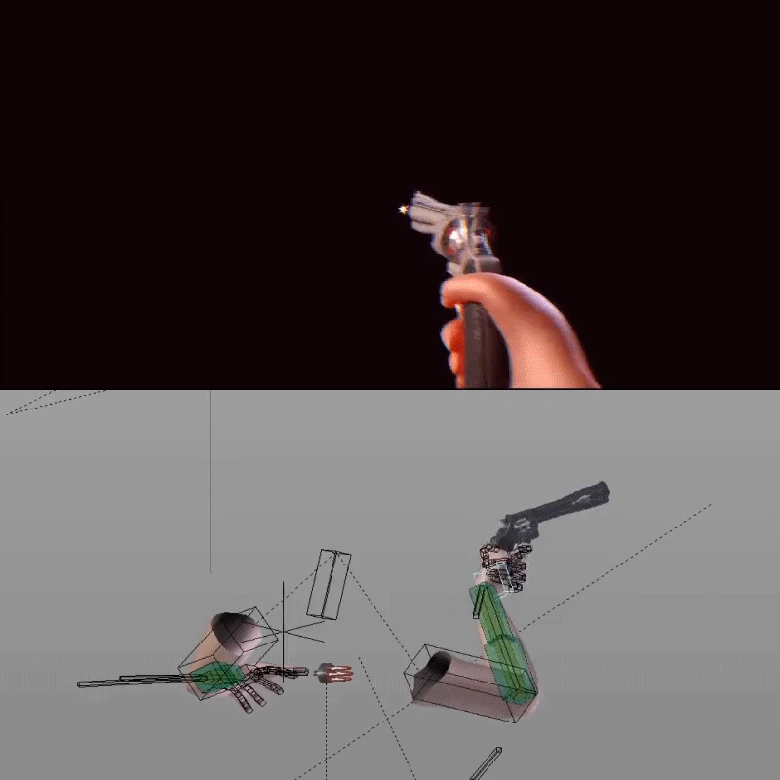
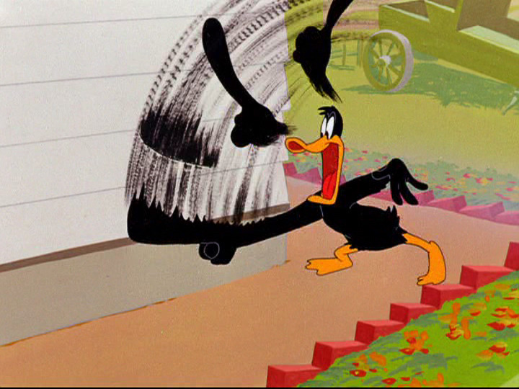
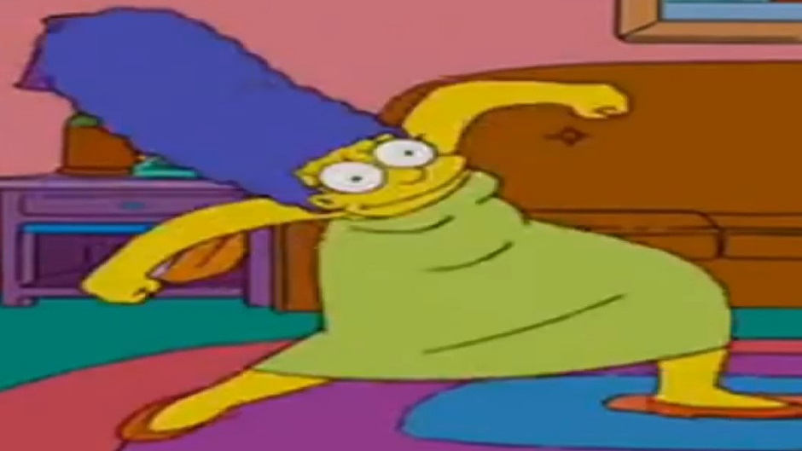
Animation

Slide 5

Portal cubes

Slide 6
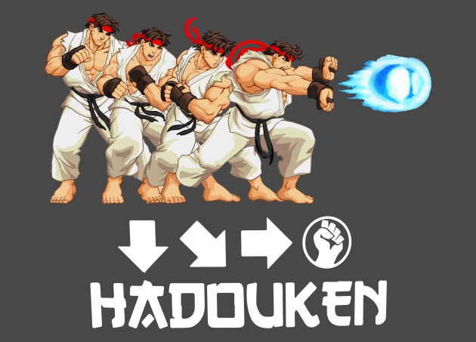
Controller and Control schemes
Dpad vs joystick

